Slide 1



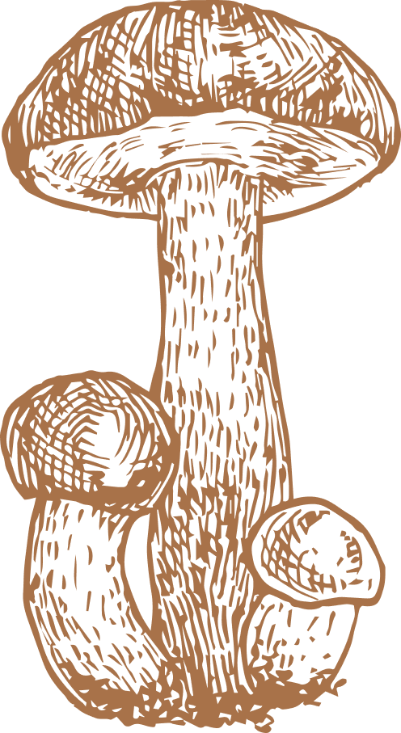




Improving Fungi Classification with Metadata Integration
Rachel Kalafos, Ryan Farhat-Sabet, William Seward
DATASCI 207, Prof. Livinisky

Slide 2



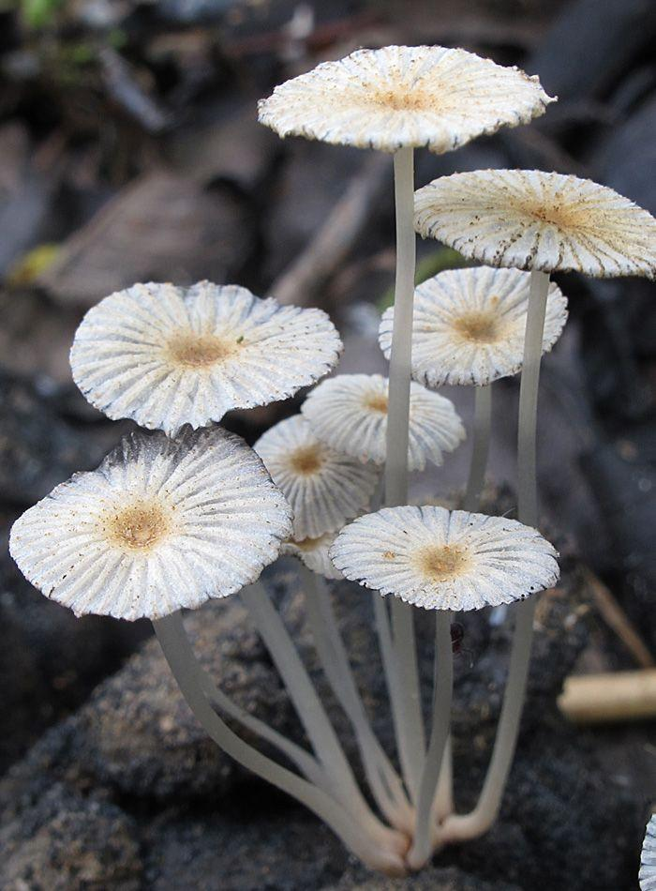

Table of Contents
01
Motivation
04
Experiments
Research Question
CNN only, CNN + Metadata, FFNN on image data
02
Data
05
Conclusions
Summary Statistics, Preprocessing
03
Modeling
Naive → Enhanced

Slide 3



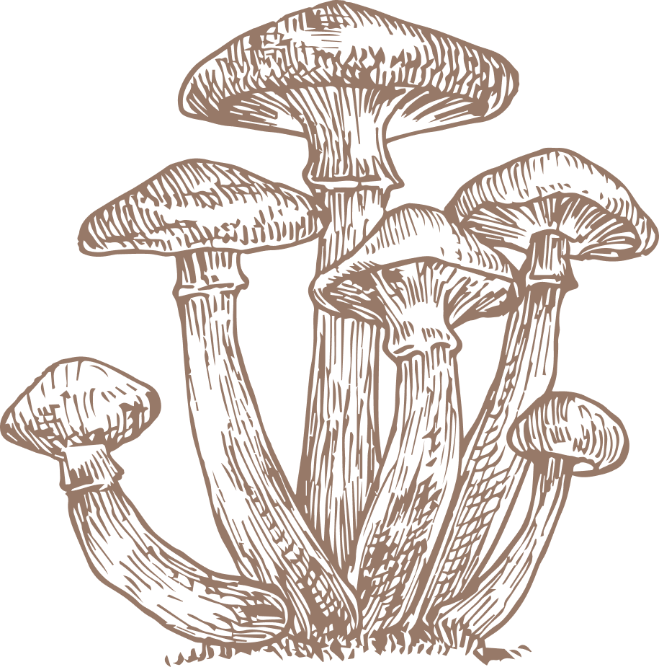

1. Motivation

Slide 4



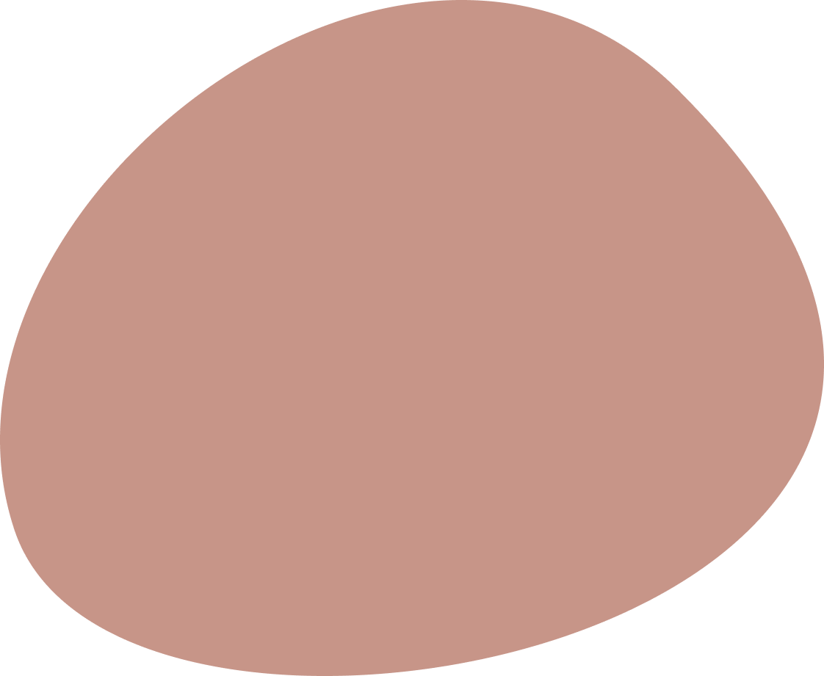

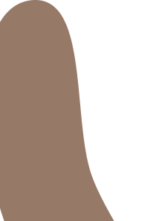
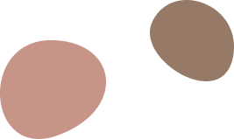
Research Question
“Can the inclusion of metadata (e.g. elevation, habitat) enhance model performance in classifying fungal taxonomic class compared to a model using only image data?”

Slide 5
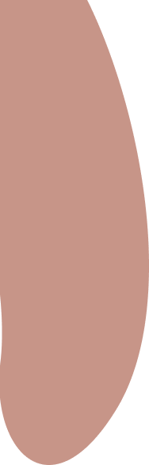



Motivation
Fungi classification has applications in…
An “automatic fungi recognition” mobile app is a fun challenge, as it would have to…
Biodiversity Tracking
Work with limited resources
Citizen Science
Learn to classify extremely rare fungi
Conservation Efforts
Visually distinguish similar species

Slide 6
Initial Approach
Build a baseline CNN model that classifies fungi into classes using only image data.
2.
Design a multi-input neural network that also includes spatial and environmental metadata.
3.
Use strategies to mitigate class imbalance (image augmentation, downsampling, filtering).

Slide 7
Summary of Results
The addition of tabular metadata boosts the accuracy of the CNN
FFNN performs better than a CNN on this particular problem
Class imbalance proved to be a major challenge

Slide 8
2. Data

Slide 9
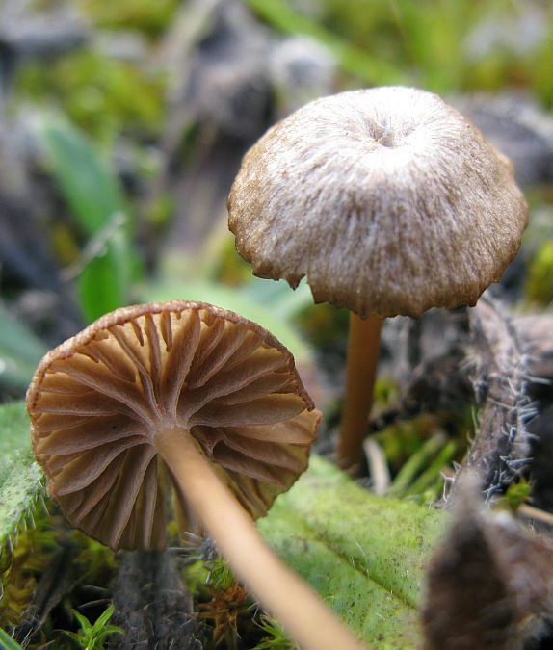

Data
Dataset:
FungiCLEF 2025 (Kaggle Competition)
6,391 unique fungal observations, 12,015 total images
Each observation = 1 fungus found in the wild, often with multiple photos
Each observation includes images + metadata
Target Variable:
Taxonomic class (e.g., Agaricomycetes, Leotiomycetes)
- More common and stable across observations
Image Features:
RGB photos with 300px width
Metadata Features:
Numerical: latitude, longitude, elevation
Categorical: habitat, land cover, substrate, region

Slide 10
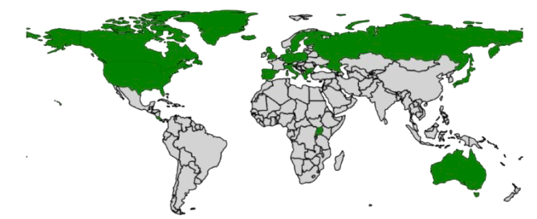
Summary Statistics
Origins of fungal samples
Image Counts
Train: 5,571 images
Val: 1,406 images
Test: 2,180 images

Slide 11
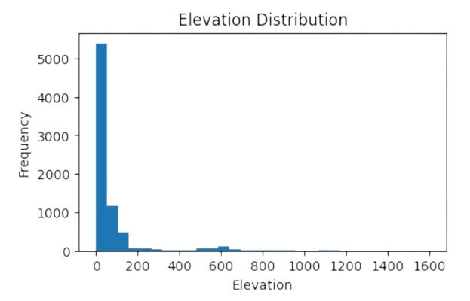
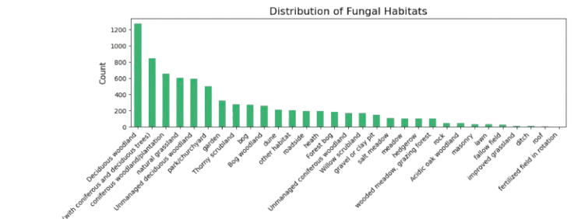
Metadata Skew
The metadata fields of interest (elevation and habitat) tend to skew
Notes:
Distribution of metadata fields was very skewed

Slide 12
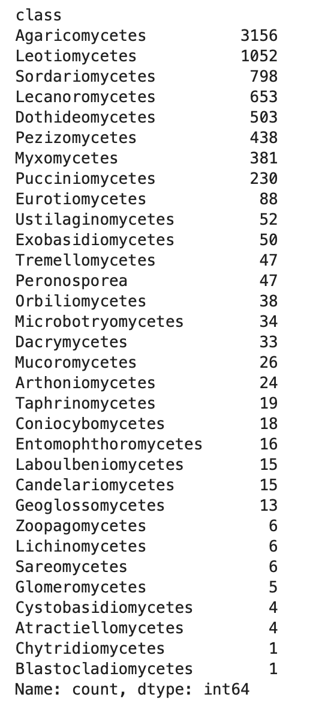
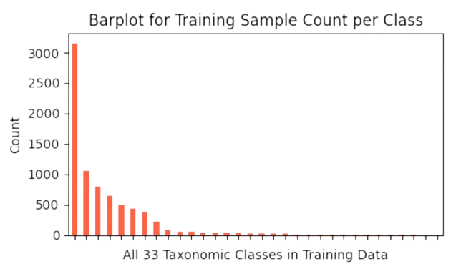
Class Imbalance Strategy
Severe class imbalance, initial models learned how to predict majority
Goal: aim for 600 images per class
Remove classes that have only 1 image
How we did this:
Augment enough images in the minority classes to meet threshold
Also experimented with downsampling to meet threshold

Slide 13

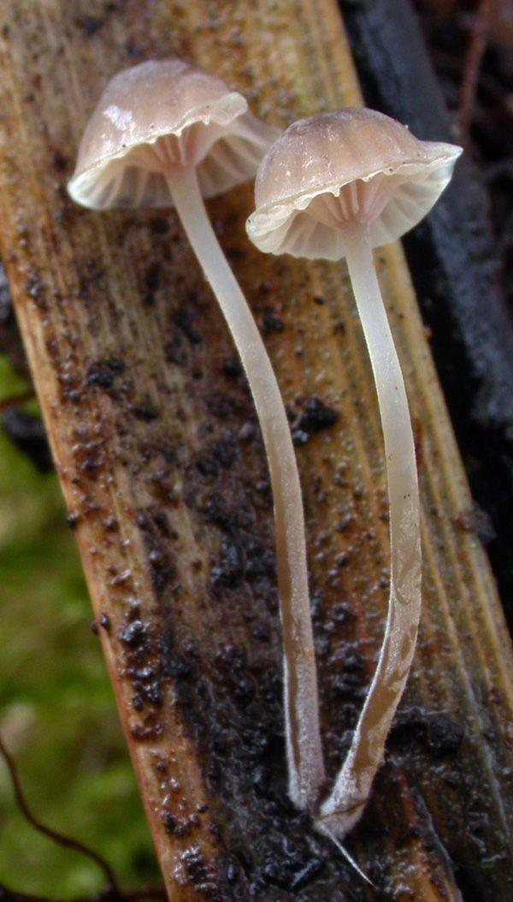
Image Augmentation
Problem: all images were of different sizes
Shrinking images while keeping aspect ratio
Padding to fill out desired dimensions (224x224)
Problem: class imbalance, certain classes with too few images
Random image augmentations
flip_left_right
flip_up_down
adjust_brightness
adjust_contrast

Slide 14
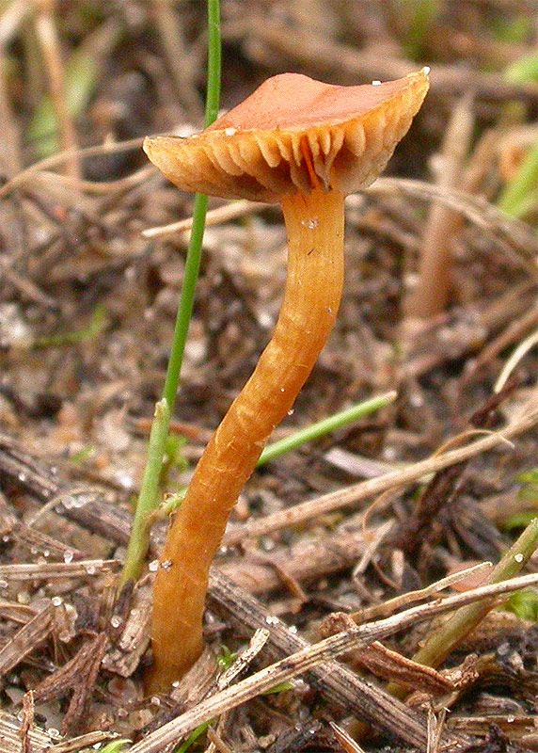


Overall Preprocessing Steps
In General:
Remove classes with only one image so we can stratify
Augment/downsample images due to class imbalance
For Images:
Rescale
Shrink according to aspect ratio
Padding
Normalize
For Metadata:
Remove observations with missing data (no imputation)
Normalize elevation
Habitat embeddings

Slide 15
3. Modeling

Slide 16

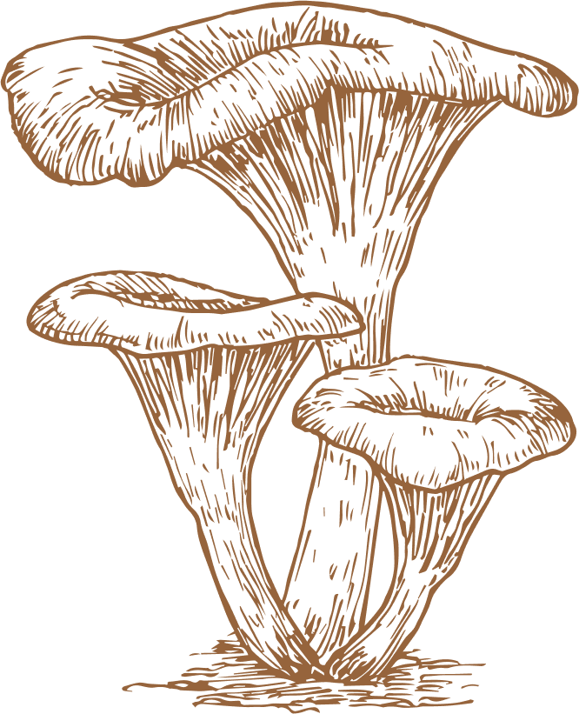
Modeling
Naive Baseline: most common taxonomic class
All class predictions are “Agaricomycetes”, being the majority class
Baseline Modeling: CNN (Image Only)
Basic experimental architecture:
Layers: [(Convolution -> Pooling -> Dropout) repeated] -> Flatten -> Dense
Enhanced Modeling: Multi-Input Neural Network
Architecture:
Three branches:
CNN branch for image data
Fully connected branches for metadata (elevation, habitat)
Both branches are concatenated before passing through a final dense layer for multi-class classification
Extra Modeling: Feed-Forward Neural Net

Slide 17
4. Experiments

Slide 18



Experiments
Goal: Evaluate how different modeling choices affect classification accuracy for fungal classes, especially under class imbalance and with limited data.
Model Type | Test Accuracy
Naive Baseline (majority class) | 3.3%
Image-Only CNN | 2.4%
Multi-Input Network | 8.2%
Feed-Forward Neural Network | 11.1%
Notes:
a lot of our customization and tuning had more to do with the preprocessing than hyperparameter tuning (running all of these models with different preprocessing methods); limited by compute; these were the accuracies of our final models

Slide 19
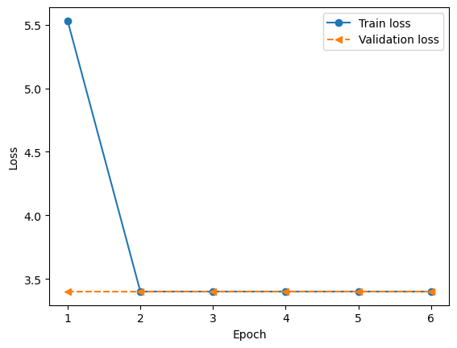
Image-only CNN
Layers | Params
Conv2D (filters=32, kernel_size=4, padding="same", activation="relu") | 1,568
MaxPool2D | 0
Dropout(0.25) | 0
Flatten | 0
Dense(activation=”softmax”) | 12,042,270
Accuracy: 2.4%

Slide 20
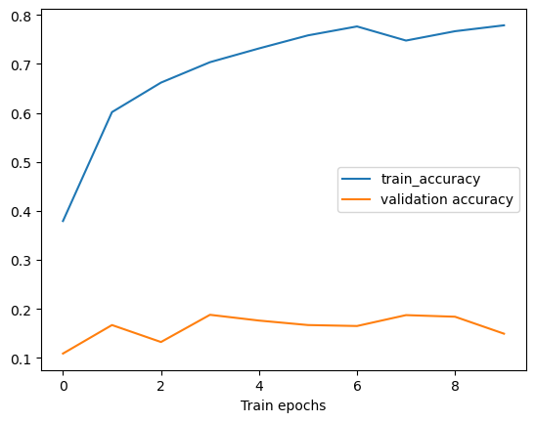
Multi-Layer with Metadata
Image Layer | Elevation Layer | Habitat Layer
Conv2D (filters=32, kernel_size=4, padding="same", activation="relu") | Normalization | StringLookup
MaxPool2D |  | Embedding
Dropout(0.3) |  | Flatten
Flatten
Dense(activation=”softmax”)
Concatenate
Accuracy: 8.2%

Slide 21
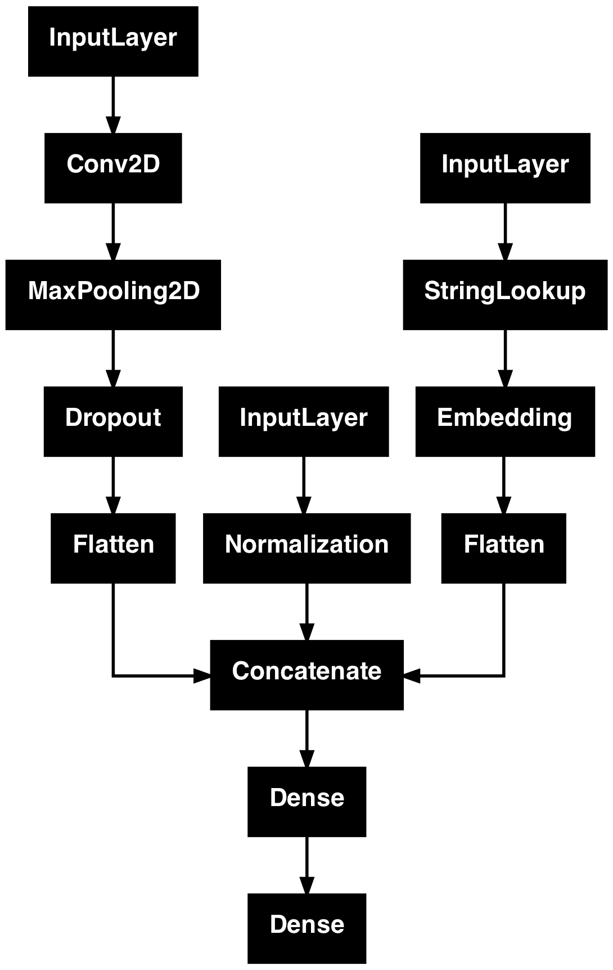
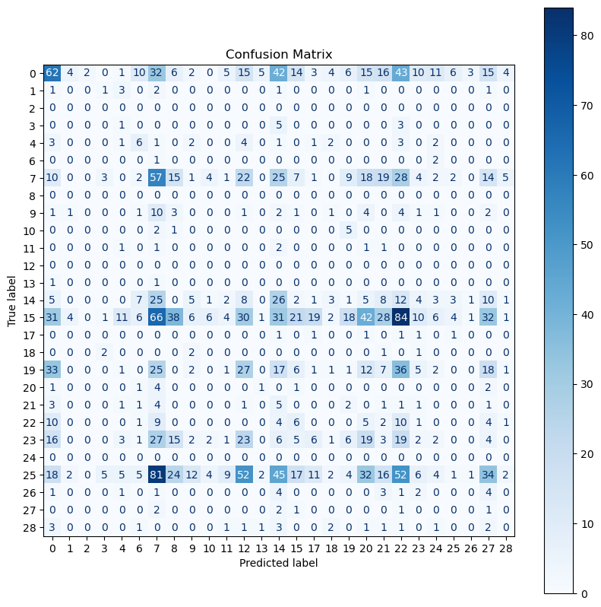
Multi-Layer with Metadata

Slide 22
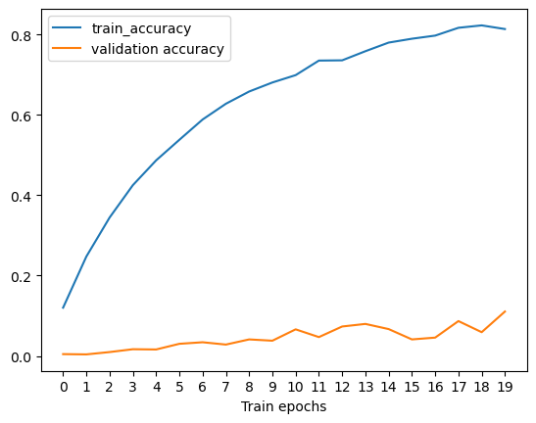
Feed-Forward Neural Net
Hyperparams
Hidden Layers | [256,128,64]
Activation | relu
Optimizer | SGD
Learning Rate | 0.01
Epochs | 20
Accuracy: 11.1%

Slide 23
5. Conclusion

Slide 24
Conclusions
Key Takeaways
What We Learned
Future Work
We showed that additional metadata can improve classification
Simpler models can perform better than more complicated ones
Class imbalance is a major challenge
Takes a lot of compute (computer would crash)
Rare fungi classes (<10 observations) are difficult to augment
We could have started with the metadata only approach, then experimented combining it with a CNN to see if the accuracy would improve
Spend more time with CNN development
Explore advanced architectures
Few-shot learning techniques
Move towards species-level prediction

Slide 25
GitHub Repo Link
https://github.com/kalafosaurus/207-final-project

Slide 26
Contributions
Rachel
Ryan
Will
EDA
Experimented with different image preprocessing and data cleaning techniques
Experimented with data augmentation
Created baseline CNN
Experimented with balancing classes
Attempted to stratify splits
Contributed to slide deck
Built and ran all our models: image-only CNN, CNN with metadata using functional API, FFNN
Wrote lots of code:
image preprocessing, keeping aspect ratios when resizing, padding, etc
creating embeddings for habitat
class imbalance image augmentation and downsampling
Also helped with slides
Contributed to data prep and preprocessing
Designed and trained CNN for multi-class classification
Addressed class imbalance through data augmentation (e.g., rotations, flips) and downsampling
Evaluated in-memory vs. disk-based augmentation to balance training speed / storage constraints
Gained practical experience in building and tuning CNNs
Had fun with slides

